Slide 1
September 2022 Financial Presentation

Slide 2
HTC Metro District Financial Presentation – September 2022
HTC Metro District: A quasi-municipal local government body, and a political subdivision of the State of Colorado. It is primarily responsible for the maintenance of the HTC common areas accepted from the Developer including roads, sidewalks, landscaping, irrigation, and snow removal. The HTC Clubhouse and related area is not the responsibility of the HTC Metro District.
HTC Metro District Board Members & Term Expiration: (all Board members are residents of HTC)
Rod Stone, President/Chair 5/2025
Phil Anderson, Vice President 5/2023
Paul Ozanich, Treasurer 5/2023
Karl Wilmes, Secretary 5/2023
Bob Tade, Assistant Secretary 5/2025

Slide 3
HOAs in HTC:
Master HOA
Attached Home HOA
Townhome Home HOA
NOTE: The Todd Creek Village Metro District (TCVWD water supplier to HTC) is not a part of HTC
HTC Metro District Committees:
Budget Committee: Phil Anderson, Paul Ozanich
Engineering Committee: Phil Anderson, Robert Tade
Landscape Committee: Rod Stone, Karl Wilmes
Special Committees:
HTC Landscaping Advisory Committee
Traffic Calming Advisory Committee
Entrance Gate Advisory Committee (Dissolved at May 23, 2022 @ HTC Metro District Board meeting)

Slide 4
HTC Metro District Bond Summary:
Bonds | Type | Date | Term | End Date | Original Amount | Call Date | Rate | Current Balance
2007A | Primary | 05/09/07 | 30 Year | 2037 | $10,420,000 | 2017 | 5.5% | $0
2007B | Subordinate | 05/22/07 |  |  | $17,462,000 |  | 7.5% | $4,817,175 after 2015 refi
2015 | Primary | 04/29/15 | 30 Year | 2045 | $22,225,000 | 2025 | 6.0 – 6.125% | $22,225,000
2020 | Primary | 11/20/20 |  | 2037 | $8,984,000 |  | 2.49% | refi of 2007A

Slide 5
HTC Metro District Bonds:
Developer Paid Development Fees: (used for Debt Service)
2015 $ 43,437
2016 $ 735,446
2017 $ 772,218
2018 $ 779,402
2019 $ 732,575
2020 $ 769,203
2021 $ 662,139
2022 $ 0
$ 4,494,420

Slide 6
HTC Metro District Mill Levies and Use:
Mill Levy | Debt Service | Operating | Total | Assessed Valuation
2015 | 54.000 | 10.000 | 64.000 | $14,732,990
2016 | 50.000 | 10.000 | 60.000 | $20,109,910
2017 | 50.000 | 10.000 | 60.000 | $23,595,270
2018 | 53.946 | 10.000 | 63.946 | $30,556,460
2019 | 54.302 | 10.000 | 64.302 | $34,268,110
2020 | 54.622 | 10.000 | 64.622 | $41,039,660
2021 | 55.024 | 10.000 | 65.024 | $41,798,450
2022 | 55.024 | 10.000 | 65.024 | $46,360,960

Slide 7
HTC Metro District Fees ($/Qtr):
2015 $150.00
2016 $150.00
2017 $150.00
2018 $150.00
2019 $150.00
2020 $150.00
2021 $150.00
2022 $165.00 ($165/Qtr started 2nd Qtr 2022)

Slide 8
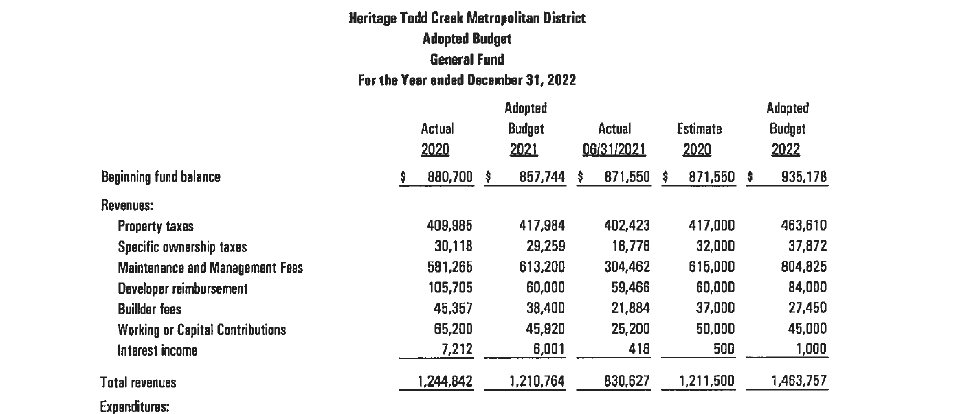
HTC Metro District 2022 Budget:
https://acrobat.adobe.com/link/track?uri=urn:aaid:scds:US:1a586121-2ef4-3625-916c-93b136f006e4

Slide 9
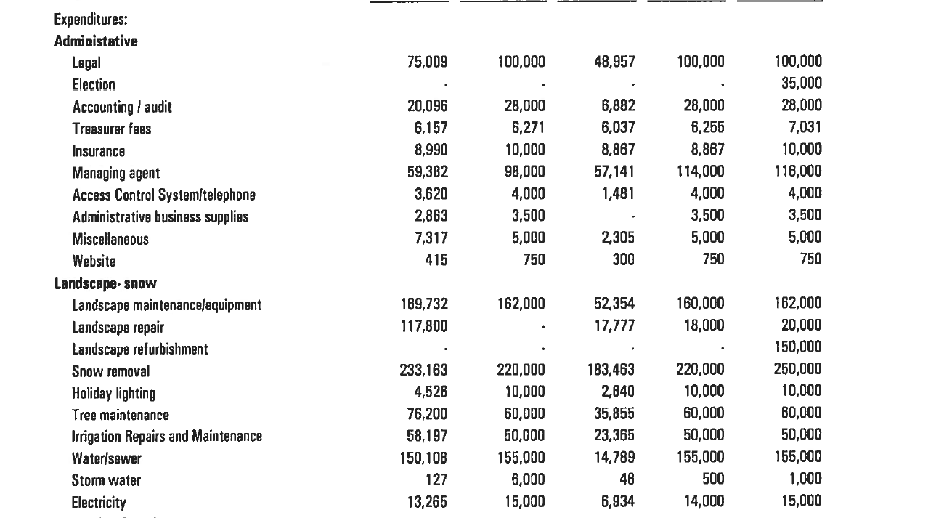
HTC Metro District 2022 Budget:

Slide 10
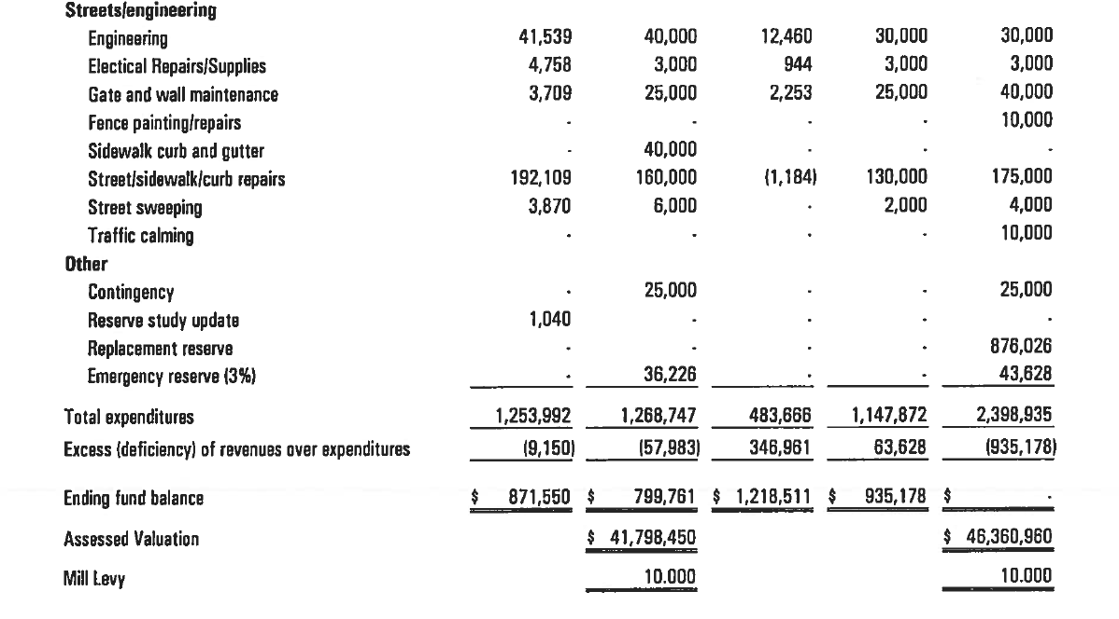
HTC Metro District 2022 Budget:

Slide 11
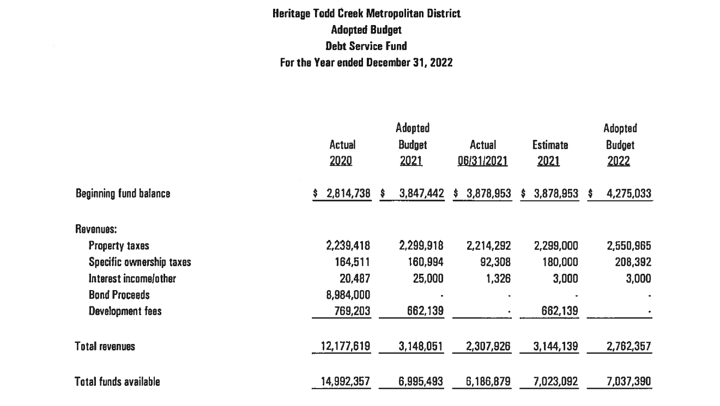
HTC Metro District 2022 Operating & Debt Service 7/22 YTD:

Slide 12
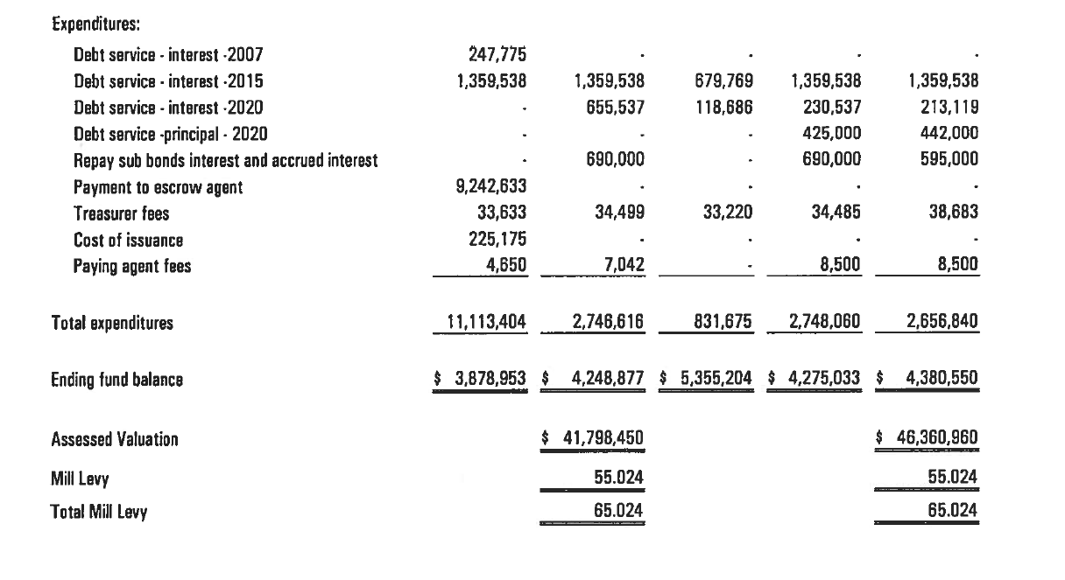
HTC Metro District 2022 Operating & Debt Service 7/22 YTD:

Slide 13
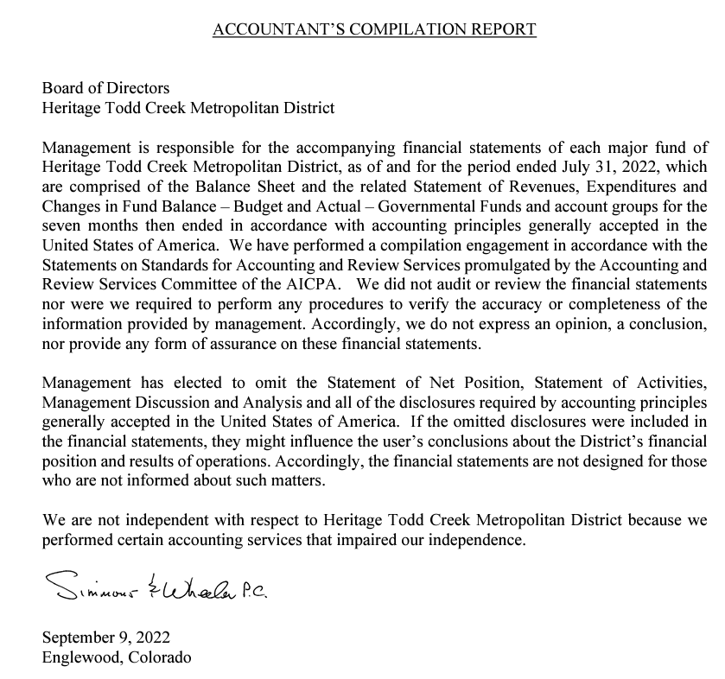
HTC Metro District Financial Statements – July 31, 2022
https://acrobat.adobe.com/link/track?uri=urn:aaid:scds:US:a047be5d-52da-3773-b1ed-6516fb5d9e80

Slide 14
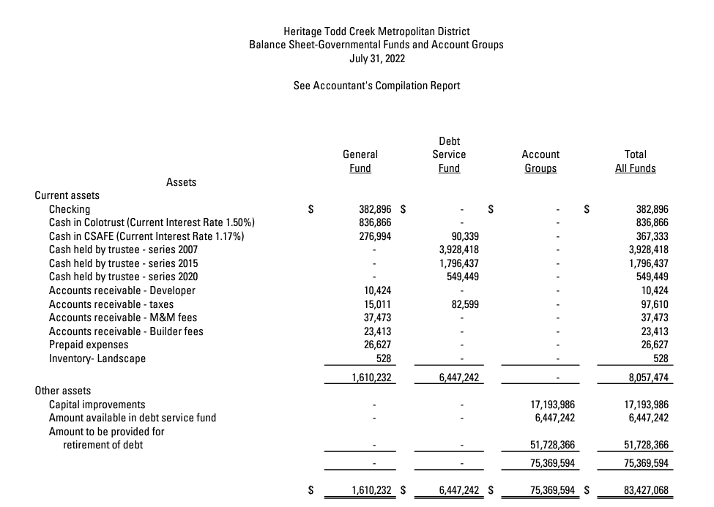

Slide 15
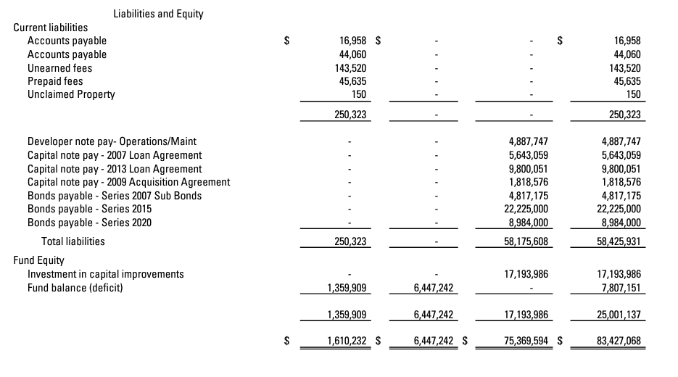

Slide 16
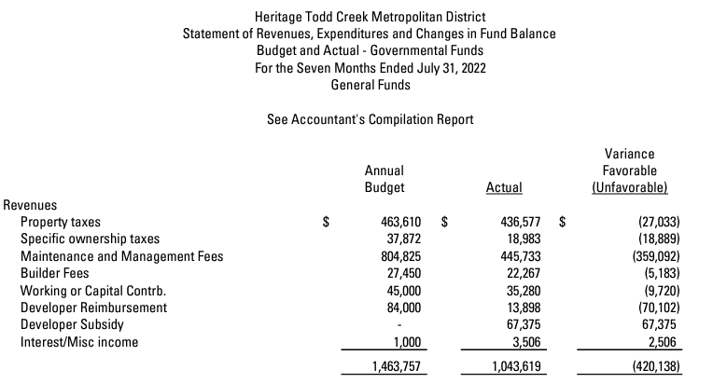

Slide 17
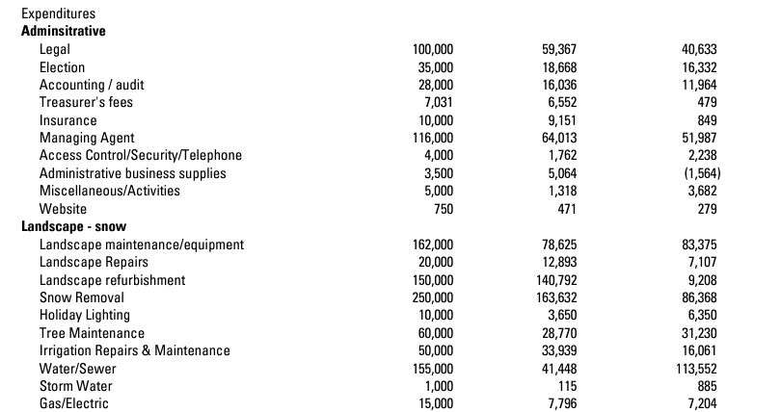

Slide 18
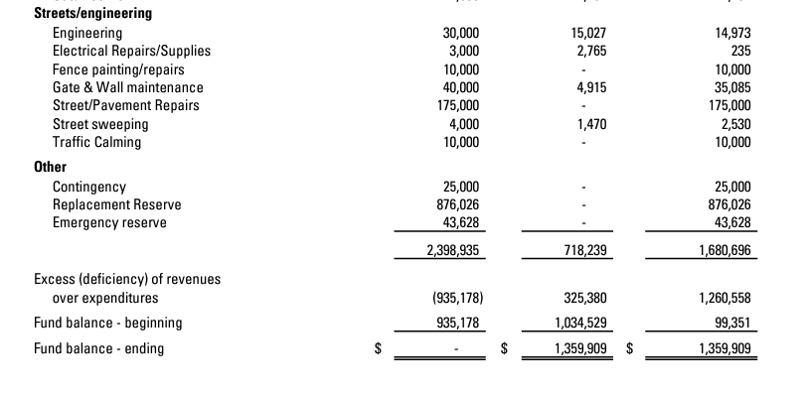

Slide 19
